Slide 1
Chapter 2: PC Assembly
Instructor Materials
IT Essentials v7.0
Notes:
Cisco Networking Academy Program
IT Essentials 7.0
Chapter 2: PC Assembly

Slide 2
Instructor Materials – Chapter 2 Planning Guide
This PowerPoint deck is divided in two parts:
Instructor Planning Guide
Information to help you become familiar with the chapter
Teaching aids
Instructor Class Presentation
Optional slides that you can use in the classroom
Begins on slide #16
Note: Remove the Planning Guide from this presentation before sharing with anyone.
Notes:
2

Slide 3
Chapter 2: PC Assembly
IT Essentials 7.0 Planning Guide
Notes:
Cisco Networking Academy Program
IT Essentials v7.0
Chapter 2: PC Assembly

Slide 4
Check Your Understanding and What Do You Already Know?
Check Your Understanding activities used to be called Interactive Activities. They simply have a new name. They are designed to let students quickly determine if they understand the content and can proceed, or if they need to review.
Check Your Understanding activities do not affect student grades.
Activities listed as What Do You Already Know? are a type of activity in which we ask the student to simply take a guess! It is not meant to evaluate their knowledge. It is only meant to give them a head start in thinking about different topics before they are presented in the course. Students receive addition content in the form of feedback for any answers they select.
What Do You Already Know? activities do not directly affect student grades; however, the feedback may contain content which appears later in quizzes and exams, so it is important that students complete the What Do You Already Know? activities.
There are no separate slides for these activities in the PPT. They are listed in the notes area of the slide that appears before these activities.
Notes:
4

Slide 5
Chapter 2: Activities
What activities are associated with this chapter?
Page # | Activity Type | Activity Name | Optional?
2.1.1.1 | Video Explanation | General and Fire Safety | Recommended
2.1.2.1 | Video Explanation | Install the Power Supply | Recommended
2.1.2.2 | Check Your Understanding | Install the Power Supply | Recommended
2.1.2.5 | Lab | Install the Power Supply | Recommended
2.1.3.1 | Video Demonstration | Install the CPU | Recommended
2.1.3.2 | Check Your Understanding | Install the CPU | Recommended
2.1.3.3 | Video Demonstration | Install the RAM | Recommended
2.1.3.4 | Check Your Understanding | Install the RAM | Recommended
2.1.3.5 | Video Demonstration | Install the Motherboard | Recommended
2.1.3.6 | Check Your Understanding | Install the Motherboard | Recommended
2.1.3.10 | Lab | Install the Motherboard in a Computer | Recommended
Notes:
5

Slide 6
Chapter 2: Activities (Cont.)
What activities are associated with this chapter?
Page # | Activity Type | Activity Name | Optional?
2.1.4.1 | Video Demonstration | Install the Drives | Recommended
2.1.4.6 | Check Your Understanding | Installing Drives | Recommended
2.1.4.7 | Lab | Install the Drives | Recommended
2.1.5.1 | Video Demonstration | Install the Adapter Cards | Recommended
2.1.5.5 | Check Your Understanding | Installing Adapter Cards | Recommended
2.1.5.6 | Lab | Install Adapter Cards | Recommended
2.1.6.3 | Check Your Understanding | Match the Media Card to its Description | Recommended
2.1.7.1 | Video Demonstration | Connect the Internal Power Cables | Recommended
2.1.7.2 | Check Your Understanding | Identify the Power Connectors | Recommended
2.1.7.3 | Video Demonstration | Connect the Internal Data Cables | Recommended
Notes:
6

Slide 7
Chapter 2: Activities (Cont.)
What activities are associated with this chapter?
Page # | Activity Type | Activity Name | Optional?
2.1.7.4 | Lab | Install Internal Cables | Recommended
2.1.7.5 | Video Demonstration | Install the Front Panel Cables | Recommended
2.1.7.7 | Check Your Understanding | Identify the Front Panel Cables | Recommended
2.1.7.8 | Lab | Install the Front Panel Cables | Recommended
2.1.7.9 | Video Demonstration | Complete the Computer Assembly | Recommended
2.1.7.10 | Check Your Understanding | Identify the External Connectors | Recommended
2.1.7.11 | Lab | Complete the Computer Assembly | Recommended
Notes:
7

Slide 8
Chapter 2: Assessment
Students should complete Chapter 2, “Assessment” after completing Chapter 2.
Quizzes, labs, and other activities can be used to informally assess student progress.
Notes:
8

Slide 9
Chapter 2: Best Practices
Prior to teaching Chapter 2, the instructor should:
Complete Chapter 2, “Assessment.”
The objective of this chapter is to build a computer.
Notes:
9

Slide 10
Chapter 2: Best Practices (Cont.)
Installing components in order to build, repair, or upgrade personal computers is important. Some things you might want to emphasize as you are working inside the PCs:
Safety
Powering down and removing power before starting
Removing personal items – dangling IDs, watches, jewelry
Clear space to work
Sharp edges – note you may want to have bandaids in the classroom
Lifting safety
Fire extinguisher demo – invite the safety officer for a 5 minute demo of using an extinguisher
Inside the computer is low voltage
ESD and preventing damage to sensitive components such as RAM
Special attention should be given to explain, demonstrating, or installing CPUs. Explain pin 1 and the notched processor socket.
Notes:
10

Slide 11
Chapter 2: Best Practices (Cont.)
CPU idea – You might consider have a separate area where students can practice removing/installing CPUs on old motherboards that are not mounted in the computer. This allows the student to feel less intimidated by one part that is scary to even a seasoned technician who has not installed many.
Current CPUs have the pins inside the socket rather than on the CPUs.
RAM – Be sure to advise the students not to force the connection. If resistance is felt, check notch alignment and press straight down until the tabs can be safely and securely placed into the side of the module.
Some teachers like lecturing as the students are disassembling the computer, making them stop and listen between steps.
A less intimidating way to disassemble the computer is to team the students up in pairs and make them disassemble the computer in lock step, documenting along the way with phone pictures, hand drawn diagrams, notes, etc. that they create. Then allow them to reassemble at their own pace, troubleshooting themselves for anything that doesn’t work. Assistance may be needed from the instructor to help them with their logic of where to start.
Notes:
11

Slide 12
Chapter 2: Best Practices (Cont.)
If computers are limited but Internet access or printed parts lists are available, you might have some students disassembling the computer while other students are shopping for a particular part they would choose such as a power supply.
If shopping, this would be a good time to introduce the students to some of the web sites used for computer parts. Note that some of these sites have power supply calculators, RAM software, or other tools to help when selecting parts.
PCPARTPICKER: https://pcpartpicker.com/
NEWEGG: https://www.newegg.com/
TigerDriect: http://www.tigerdirect.com/
CDW: https://www.cdw.com
Crucial: https://www.crucial.com/
Kingston: https://www.kingston.com
Showing motherboard and/or case form factors help terms like ATX or micro-ATX is good to reinforce and demonstrate in this chapter.
Notes:
12

Slide 13
Chapter 2: Best Practices (Cont.)
Be especially mindful and caution the students on making notations as to which SATA connector the hard drive and/or optical drive connects. Connecting the cable to the wrong motherboard connector can cause the computer not to boot.
Warn students of proper handling of mechanical hard drives.
When disassembling, cable removal is an art. Some cables take wiggling slightly back and forth while edging the cable out of the socket is recommending. Tugging on the cable could cause the cable to disconnect from the connector and no longer work.
Practice installing cards of any type into any socket so the students get the experience of (1) gaining access to the sockets as manufacturers use a variety of methods, (2) how much pressure has to be exerted to push adapters into a socket, especially if the socket has not been used before, and (3) confidence in doing so in a classroom environment which is less threatening and provides practice time.
Notes:
13

Slide 14
Chapter 2: Additional Help
For additional help with teaching strategies, including lesson plans, analogies for difficult concepts, and discussion topics, visit the ITE Community at: https://community.cisco.com/t5/networking-academy/ct-p/Netacad, or simply go to https://community.cisco.com.
If you have lesson plans or resources that you would like to share, upload them to the ITE Community in order to help other instructors.
Notes:
14

Slide 15
Chapter 2: PC Assembly
IT Essentials v7.0
Notes:
Cisco Networking Academy Program
IT Essentials 7.0
Chapter 2: PC Assembly

Slide 16
Chapter 2 - Sections & Objectives
2.1 Assemble the Computer
Build a computer.
Define general and fire safety standards.
Connect the power supply.
Install the motherboard components.
Install internal drives.
Install the adapter cards.
Identify additional storage.
Connect computer components with appropriate cables.
Notes:
16
Cisco Networking Academy Program
IT Essentials v7.0
Chapter 2: PC Assembly

Slide 17
2.1 Assemble the Computer
Notes:
2 – PC Assembly
2.1 – Assemble the Computer

Slide 18
General and Fire Safety Video Explanation – General and Fire Safety
In this video explanation, you will learn about the general and fire safety precautions while working in a computer:
Remove watches or jewelry
Turn off and unplug equipment
Remove clutter from workspace
Cover sharp edges inside the computer
Wear safety goggles
Proper lifting procedures
Fire extinguisher availability, rating, and use
Notes:
2.1 – Assemble the Computer
2.1.1 – General and Fire Safety
2.1.1.1 – Video Explanation – General and Fire Safety

Slide 19
Open the Case and Connect the Power Supply Video Demonstration – Install the Power Supply
This is a video demonstration about installing the power supply:
Step 1: Open the computer case
Step 2: Align the screw holes on the power supply with the mount on the computer case.
Step 3: screw the power supply into place.
Notes:
2.1 – Assemble the Computer
2.1.2 – Open the Case and Connect the Power Supply
2.1.2.1 – Video Demonstration – Install the Power Supply
2.1.2.2 – Check Your Understanding – Install the Power Supply

Slide 20
Open the Case and Connect the Power Supply Select the Case and Fans
Model Type – The motherboard determines the type of case you can use. The size and shape must match.
Size – A computer with many components will need more room for airflow to keep the system cool.
Power Supply – Match the power supply rating and connection type to the motherboard.
Appearance – There are many case designs to choose from.
Status Display – LEDs mounted on outside of case tell you if the system has power, when the hard drive is in use, and when the computer is in sleep or hibernate mode.
Vents – All cases have a vent on the power supply, and some have a vent in the back to draw air out of into the system. Some cases have even more vents.
Notes:
2.1 – Assemble the Computer
2.1.2 – Open the Case and Connect the Power Supply
2.1.2.3 – Select the Case and Fans

Slide 21
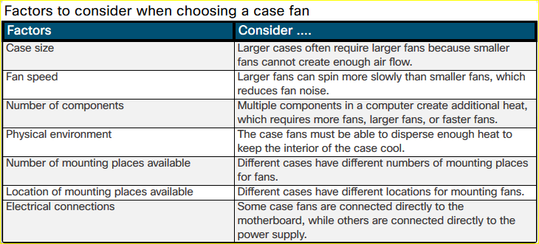
Open the Case and Connect the Power Supply Select the Case and Fans (Cont.)
Notes:
2.1 – Assemble the Computer
2.1.2 – Open the Case and Connect the Power Supply
2.1.2.3 – Select the Case and Fans (Cont.)

Slide 22
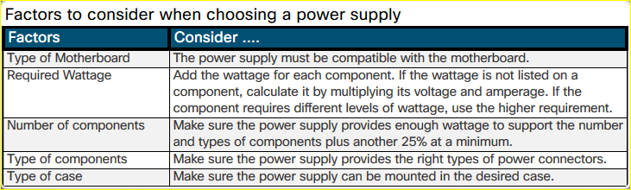
Open the Case and Connect the Power Supply Select a Power Supply
Notes:
2.1 – Assemble the Computer
2.1.2 – Open the Case and Connect the Power Supply
2.1.2.4 – Select a Power Supply

Slide 23
Open the Case and Connect the Power Supply Lab – Install the Power Supply
In this lab, you will install a power supply in a computer case.
Notes:
2.1 – Assemble the Computer
2.1.2 – Open the Case and Connect the Power Supply
2.1.2.5 – Lab – Install the Power Supply

Slide 24
Install the Motherboard Components Video Demonstration – Install the CPU
This is a video demonstration about installing the CPU:
Step 1: Orient the CPU to the CPU slot.
Step 2: Press the CPU into the CPU slot.
Step 3: Lock the CPU into place.
Step 4: Apply thermal paste to the CPU.
Step 5: Install the heatsink.
Step 6: Secure the heatsink.
Notes:
2.1 – Assemble the Computer
2.1.3 – Install the Motherboard Components
2.1.3.1 – Video Demonstration – Install the CPU
2.1.3.2 – Check Your Understanding – Install the CPU

Slide 25
Install the Motherboard Components Video Demonstration – Install the RAM
This is a video demonstration about installing the RAM:
Step 1: Open the RAM slot levers.
Step 2: Orient the RAM chip to the motherboard slot.
Step 3: Lower the RAM chip into the slot.
Step 4: Press down firmly to lock the RAM chip.
Notes:
2.1 – Assemble the Computer
2.1.3 – Install the Motherboard Components
2.1.3.3 – Video Demonstration – Install the RAM
2.1.3.4 – Check Your Understanding – Install the RAM

Slide 26
Install the Motherboard Components Video Demonstration – Install the Motherboard
This is a video demonstration about installing the motherboard:
Step 1: Align the motherboard in the correct direction.
Step 2: Locate the standoffs.
Step 3: Install standoffs in the computer case.
Step 4: Align I/O plate to back of computer case.
Step 5: Lower motherboard into place.
Step 6: Install the screws into the standoffs.
Notes:
2.1 – Assemble the Computer
2.1.3 – Install the Motherboard Components
2.1.3.5 – Video Demonstration – Install the Motherboard
2.1.3.6 – Check Your Understanding – Install the Motherboard

Slide 27
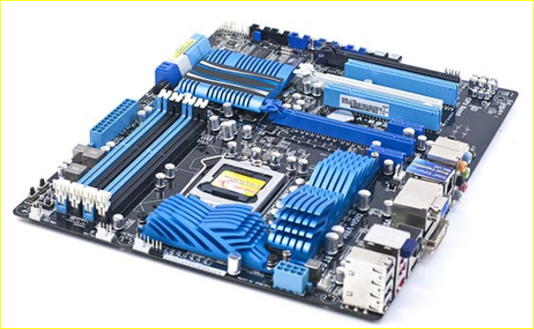
Install the Motherboard Components Select the Motherboard
When selecting a replacement motherboard, make sure that it supports or accommodates:
CPU
RAM
Video adapter, other adapter cards
Socket and chipset on motherboard are compatible with the CPU
The existing heat sink and fan assembly when reusing the CPU
The number/type of expansion slots. They must match the existing adapter cards and allow for new cards
The existing power supply connections must fit the new motherboard.
New motherboard must fit into the current computer case.
Notes:
2.1 – Assemble the Computer
2.1.3 – Install the Motherboard Components
2.1.3.7 – Select the Motherboard

Slide 28
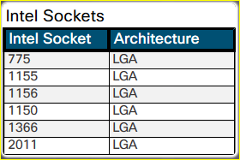
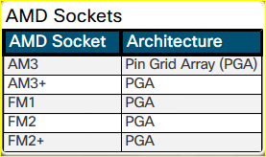
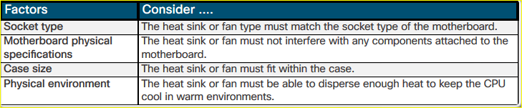
Install the Motherboard Components Select the CPU and CPU Cooling
Notes:
2.1 – Assemble the Computer
2.1.3 – Install the Motherboard Components
2.1.3.8 – Select the CPU and CPU Cooling

Slide 29
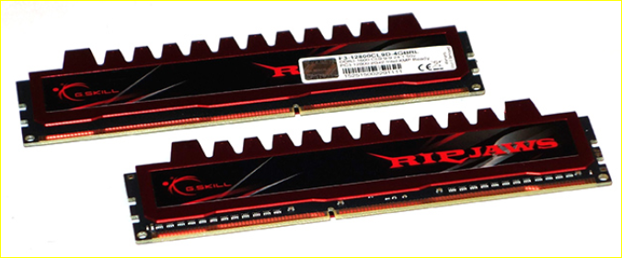
Install the Motherboard Components Select the RAM
New RAM may be needed when an application locks up or the computer displays frequent error messages. To determine if the problem is the RAM, execute the RAM test in the BIOS. The speed of the new RAM must be supported by the chipset.
Memory may also be categorized as unbuffered or buffered:
Unbuffered memory – This is regular memory for computers. The computer reads data directly from the memory banks making it faster than buffered memory.
Buffered memory – Specialized memory for servers and high-end workstations that use a large amount of RAM. These have a control chip built into the module that assists the memory controller in managing large quantities of RAM.
Notes:
2.1 – Assemble the Computer
2.1.3 – Install the Motherboard Components
2.1.3.9 – Select the RAM

Slide 30
Install the Motherboard Components Install the Motherboard in a Computer
In this lab, you will install a CPU, a heat sink/fan assembly,
and RAM module(s) on the motherboard. You will then install the motherboard into
the computer case.
Notes:
2.1 – Assemble the Computer
2.1.3 – Install the Motherboard Components
2.1.3.10 – Lab – Install the Motherboard in a Computer

Slide 31
Install Internal Drives Video Demonstration - Install the Drives
This is a video demonstration about installing the Drives:
Hard Drive
Step 1: Position the HDD so that it aligns with the drive ay opening. The power and interface connectors should be facing out towards the motherboard.
Step 2: Insert the HDD into the drive bay so that the screw holes in the drive line up with the screw holes in the case.
Step 3: Secure the HDD to the case using the proper screws.
Notes:
2.1 – Assemble the Computer
2.1.4 – Install Internal Drives
2.1.4.1 – Video Demonstration – Install the Drives

Slide 32
Install Internal Drives Video Demonstration - Install the Drives (Cont.)
This is a video demonstration about installing the Drives:
Optical Drive
Step 1: From the front of the case, choose the drive bay that you want to hold the drive. Remove the faceplate from that bay if necessary.
Step 2: Position the optical drive so that it aligns with the 5.25 inch (13.34 cm) drive bay opening at the front of the case.
Step 3: Insert the optical drive into the drive bay so that the optical drive screw holes align with the screw holes in the case.
Step 4: Secure the optical
Notes:
2.1 – Assemble the Computer
2.1.4 – Install Internal Drives
2.1.4.1 – Video Demonstration – Install the Drives (Cont.)

Slide 33
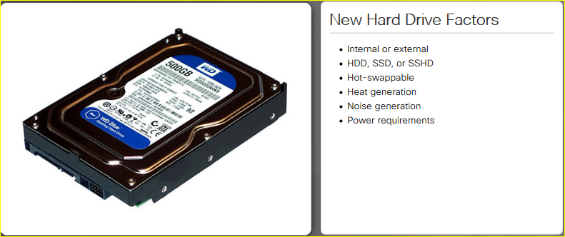
Install Internal Drives Select Hard Drives
Notes:
2.1 – Assemble the Computer
2.1.4 – Install Internal Drives
2.1.4.2 – Select Hard Drives

Slide 34
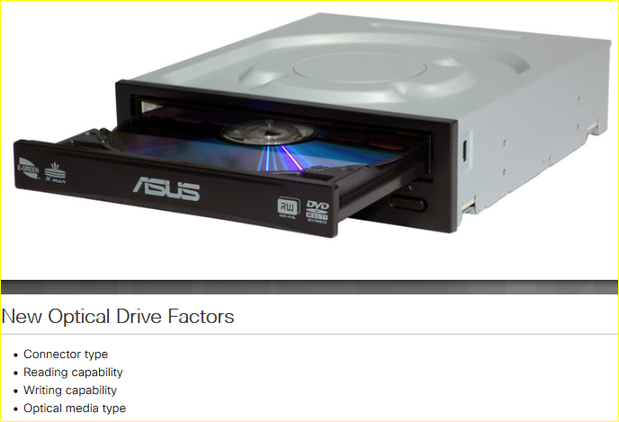
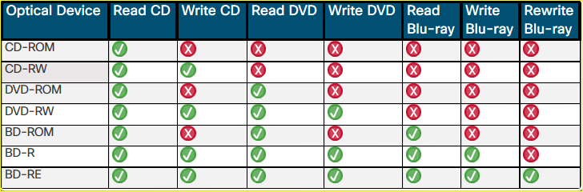
Install Internal Drives Select Optical Drives
Optical Drive Capabilities
Notes:
2.1 – Assemble the Computer
2.1.4 – Install Internal Drives
2.1.4.3 – Select Optical Drives

Slide 35
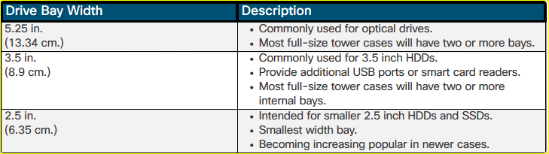
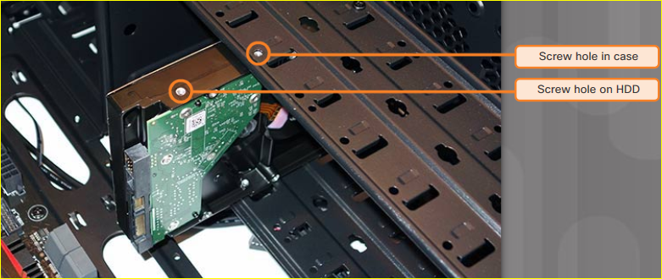
Install Internal Drives Install the Hard Drive
Notes:
2.1 – Assemble the Computer
2.1.4 – Install Internal Drives
2.1.4.4 – Install the Hard Drive

Slide 36
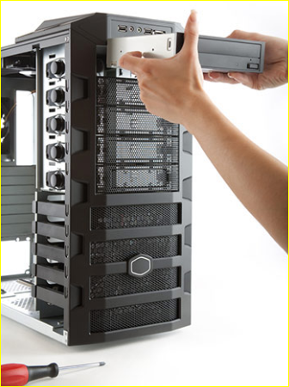
Install Internal Drives Install the Optical Drive
Step 1. From the front of the case, choose the drive bay that you want to hold the drive. Remove the faceplate from that bay if necessary.
Step 2: Position the optical drive so that it aligns with the 5.25 inch (13.34 cm.) drive bay opening at the front of the case, as shown in the figure.
Step 3. Insert the optical drive into the drive bay so that the optical drive screw holes align with the screw holes in the case.
Step 4. Secure the optical drive to the case using the proper screws.
Installation Tip: Slightly hand-tighten all the screws before tightening any of them with a screw driver. This will make it easier to tighten the last two screws.
Notes:
2.1 – Assemble the Computer
2.1.4 – Install Internal Drives
2.1.4.5 – Install the Optical Drive
2.1.4.6 – Check Your Understanding – Installing Drives

Slide 37
Install Internal Drives Lab – Install the Drives
In this lab, you will install the hard disk and optical drives.
Notes:
2.1 – Assemble the Computer
2.1.4 – Install Internal Drives
2.1.4.7 – Install the Drives

Slide 38
Install the Adapter Cards Video Demonstration – Install the Adapter Cards
This is a video demonstration about installing the Adapter Cards:
Step 1: Find an empty PCIe x16 slot on the case and remove the small metal cover.
Step 2: Align the video adapter card to the appropriate expansion slot on the motherboard.
Step 3: Press down gently on the video adapter card until it is fully seated.
Step 4: Secure the video adapter card mounting bracket to the case with the appropriate screw.
Notes:
2.1 – Assemble the Computer
2.1.5 – Install the Adapter Cards
2.1.5.1 – Video Demonstration - Install the Adapter Cards

Slide 39
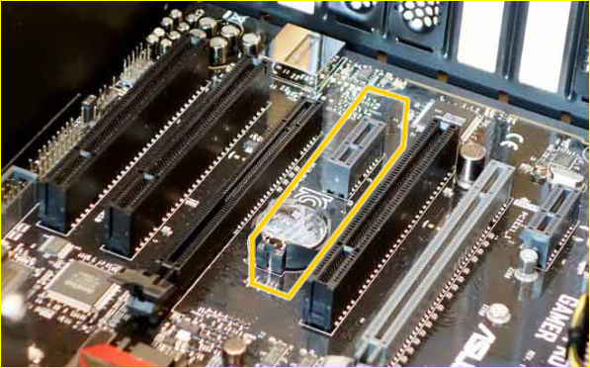
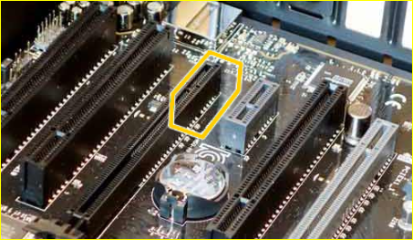
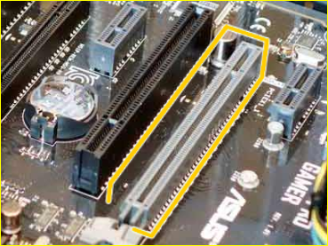
Install the Adapter Cards Select Adapter Cards
Adapter cards are designed for a specific task and add extra functionality to a computer. There are a variety of adapter cards:
Graphics
Sound
Storage Controller
I/O
NIC
Capture
Adapter cards are inserted into two types of expansion slots on a motherboard:
Peripheral Component Interconnect (PCI)
PCI Express (PCIe) – PCIe has four types of slots; x1, x4, x8, and x16.
PCI
PCIe x1
PCIe x16
Notes:
2.1 – Assemble the Computer
2.1.5 – Install the Adapter Cards
2.1.5.2 – Select the Adapter Cards

Slide 40
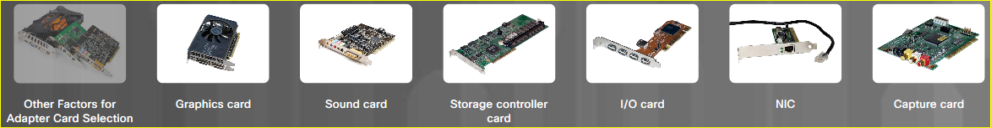
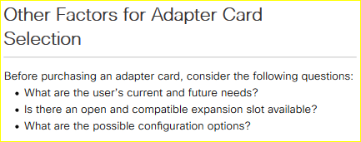
Install the Adapter Cards Other Factors for Adapter Card Selection
Notes:
2.1 – Assemble the Computer
2.1.5 – Install the Adapter Cards
2.1.5.3 – Other Factors for Adapter Card Selection

Slide 41
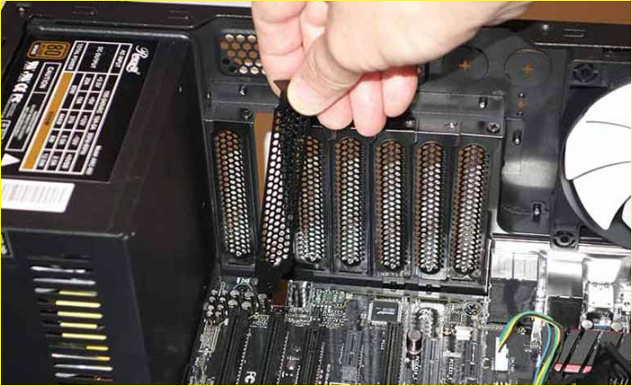
Install the Adapter Cards Install the Adapter Cards
Expansion cards are installed into an appropriate slot on the motherboard.
Installation Tip: Research the length of the video card. Longer cards may not be compatible with certain motherboards. Some adapter cards may come with mounting brackets of different heights to accommodate these cases.
Installation Tip: Some cases have small slots at the bottom of the hole where the cover was removed. Slide the bottom of the mounting bracket into this slot before seating the card.
Notes:
2.1 – Assemble the Computer
2.1.5 – Install the Adapter Cards
2.1.5.4 – Install the Adapter Cards
2.1.5.5 – Check Your Understanding – Installing Adapter Cards

Slide 42
Install the Adapter Cards Lab - Install Adapter Card
In this lab, you will install a NIC, a wireless NIC, and a video adapter card
Notes:
2.1 – Assemble the Computer
2.1.5 – Install the Adapter Cards
2.1.5.6 – Lab - Install Adapter Card

Slide 43
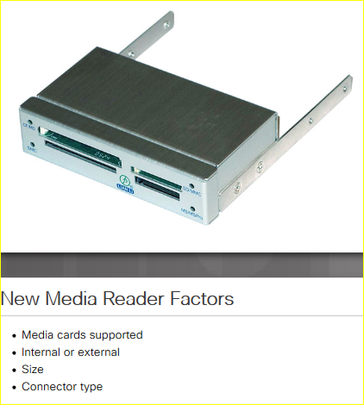
Select Additional Storage Select a Media Reader
Several media card formats have been developed over the years including:
Secure digital (SD
MicroSD
MiniSD
CompactFlash
Memory Stick
Choose a media reader based on current and future needs.
Notes:
2.1 – Assemble the Computer
2.1.6 – Select Additional Storage
2.1.6.1 – Select a Media Reader

Slide 44
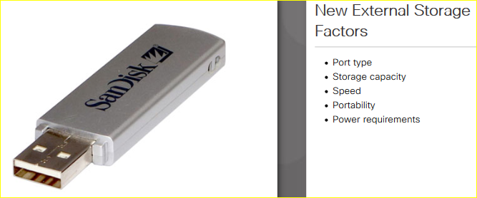
Select Additional Storage Select External Storage
External USB flash drives, sometimes called thumb drives, are commonly used as removable external storage. External storage devices connect to an external port using USB, eSATA, or Thunderbolt ports.
Choose the correct type of external storage for your customer’s needs. For example, if your customer needs to transfer a small amount of data, such as a single presentation, an external flash drive is a good choice. If your customer needs to back up or transfer large amounts of data, choose an external hard drive.
Notes:
2.1 – Assemble the Computer
2.1.6 – Select Additional Storage
2.1.6.2 – Select External Storage
2.1.6.3 – Check Your Understanding – Match the Media Card to its Description

Slide 45
Install the Cables Video Demonstration – Connect the Internal Power Cables
This is a video demonstration about connecting the internal power cables:
Step 1: Align the 24-pin ATX power connector to the socket on the motherboard.
Step 2: Gently press down on the connector until the clip clicks into place.
Step 3: Align the 4-pin auxiliary power connector to the socket on the motherboard.
Step 4: Gently press down on the connector until the clip clicks into place.
Step 5: Align the CPU fan power connector to the socket on the motherboard.
Step 6: Gently press down on the connector until the clip clicks into place.
Notes:
2.1 – Assemble the Computer
2.1.7 – Install the Cables
2.1.7.1 – Video Demonstration – Connect the Internal Power Cables
2.1.7.2 – Check Your Understanding – Identify the Power Connectors

Slide 46
Install the Cables Video Demonstration – Connect the Internal Data Cables
This is a video demonstration about connecting the internal data cables:
Step 1: Align the SATA cable and plug one end into the motherboard socket.
Step 2: Align the other end of the SATA cable and plug it into the smaller SATA port on the drive.
Notes:
2.1 – Assemble the Computer
2.1.7 – Install the Cables
2.1.7.3 – Video Demonstration – Connect the Internal Data Cables

Slide 47
Install the Cables Lab – Install Internal Cables
In this lab, you will install the internal power
and data cables in the computer.
Notes:
2.1 – Assemble the Computer
2.1.7 – Install the Cables
2.1.7.4 – Lab – Install Internal Cables

Slide 48
Install the Cables Video Demonstration – Install the Front Panel Cables
This is a video demonstration about connecting the front panel cables:
Step 1: Plug the power cable into the system panel connector in the location marked PWR_SW.
Step 2: Plug the reset cable into the system panel connector in the location marked RESET.
Step 3: Plug the power LED cable into the system panel connector in the location marked PWR_LED.
Step 4: Plug the drive activity LED into the system panel connector in the location marked HDD_LED.
Step 5: Plug the speaker cable into the system panel connector in the location marked SPEAKER.
Step 6: Plug the USB cable into the USB connector.
Step 7: Plug the audio cable into the audio connector.
Notes:
2.1 – Assemble the Computer
2.1.7 – Install the Cables
2.1.7.5 – Video Demonstration – Install the Front Panel Cables

Slide 49
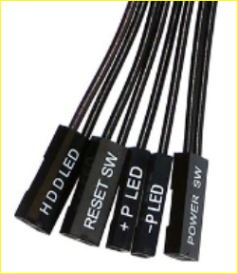
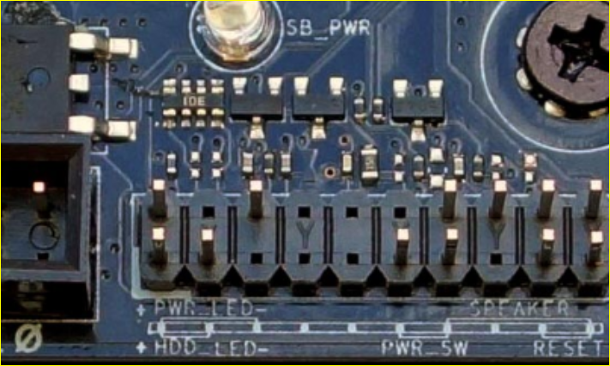
Install the Cables Install the Front Panel Cables
A computer case typically has a power button and visible activity lights on the front of the case. The case will include front panel cables that must be connected to a common system panel connector on a motherboard. Writing on the motherboard near the system panel connector shows where each cable is connected.
System Panel Connector
Front Panel Connectors
Notes:
2.1 – Assemble the Computer
2.1.7 – Install the Cables
2.1.7.6 – Install the Front Panel Cables

Slide 50
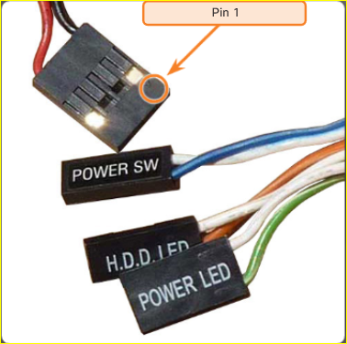
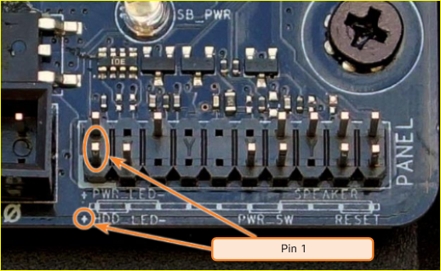
Install the Cables Install the Front Panel Cables (Cont.)
System panel connectors include:
Power Button
Reset Button
Power LED
Drive Activity LEDs
System Speaker
Audio
System panel connectors are not keyed. However, each front panel cable usually has a small arrow indicating pin 1, and each pair of LED pins on the motherboard system panel connector has pin 1 marked with a plus sign (+).
System Panel Connector Pin 1
Indicator
Pin 1 Arrow Indicator
Notes:
2.1 – Assemble the Computer
2.1.7 – Install the Cables
2.1.7.6 – Install the Front Panel Cables (Cont.)

Slide 51
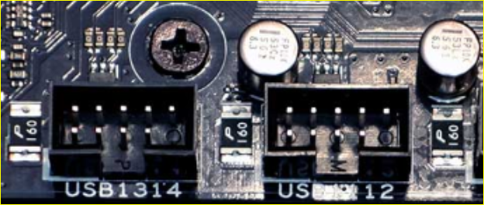
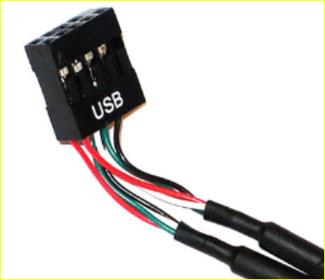
Install the Cables Install the Front Panel Cables (Cont.)
New cases and motherboards have USB 3.0 or USB 3.1 capabilities. USB connector cables are often 9 or 10 pins arranged in two rows. These cables connect to USB motherboard connectors. This arrangement allows for two USB connections, so USB connectors are often in pairs. Sometimes the two connectors are together in one piece and can be connected to the entire USB motherboard connector.
USB Motherboard Connectors
Internal USB Connector
Notes:
2.1 – Assemble the Computer
2.1.7 – Install the Cables
2.1.7.6 – Install the Front Panel Cables (Cont.)

Slide 52
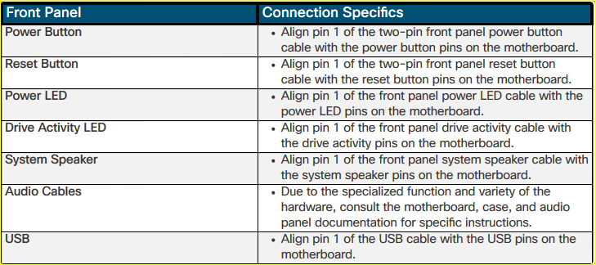
Install the Cables Install the Front Panel Cables (Cont.)
Notes:
2.1 – Assemble the Computer
2.1.7 – Install the Cables
2.1.7.6 – Install the Front Panel Cables (Cont.)
2.1.7.7 – Check Your Understanding – Identify Front Panel Connectors

Slide 53
Install the Cables Lab - Install the Front Panel Cables
In this lab, you will install the front panel cables in the computer.
Notes:
2.1 – Assemble the Computer
2.1.7 – Install the Cables
2.1.7.8 – Install the Front Panel Cables

Slide 54
Install the Cables Video Demonstration – Complete the Computer Assembly
This is a video demonstration about completing the computer assembly:
Step 1: Reattach the front panel (if necessary).
Step 2: Plug the power cable into the power supply.
Step 3: Orient and connect USB cables to USB ports.
Step 4: Orient and connect the video cable to the video port on the video adapter.
Step 5: Tighten the video cable screws to the video adapter.
Step 6: Connect the network cable to the Ethernet port.
Step 7: Connect the audio cables to the audio ports.
Step 8: Place the side panel cover onto the case and slide it closed.
Step 9: Tighten any screws to secure the side panel cover.
Notes:
2.1 – Assemble the Computer
2.1.7 – Install the Cables
2.1.7.9 – Video Demonstration – Complete the Computer Assembly
2.1.7.10 – Check Your Understanding – Identify the External Connectors

Slide 55
Install the Cables Lab – Complete the Computer Assembly
In this lab, you will install the side panels
and the external cables on the computer.
Notes:
2.1 – Assemble the Computer
2.1.7 – Install the Cables
2.1.7.11 – Lab – Complete the Computer Assembly

Slide 56
2.2 Chapter Summary
Notes:
2 – PC Assembly
2.2 – Chapter Summary

Slide 57
Conclusion Chapter 2: PC Assembly
Build a computer.
Define general and fire safety standards.
Connect the power supply.
Install the motherboard components.
Install internal drives.
Install the adapter cards.
Identify additional storage.
Connect computer components with appropriate cables.
Notes:
2.2 – Summary
2.2.1 – Conclusion
2.2.1.1 – Chapter 2: PC Assembly

Slide 58
Chapter 2 New Terms and Commands
BD-R BD-RE BD-ROM Buffered Memory CD-ROM CD-RW CompactFlash DVD-ROM DVD-RW Front-side Bus (FSB) I/O Card Memory Stick MicroSD MiniSD | Secure Digital (SD) Unbuffered Memory xD
Notes:
Chapter 2 - New Terms and Commands

